Slide 1
Introduction to Copilot (Office 365) Working Session
Cognizant GGM Tech Office
June 2024

Slide 2

Agenda
1. Introduction to Copilot
2. Working Session - Copilot for
Word
PowerPoint
Office
Excel
Teams
3. Reading Suggestions
4. Way Forward Ideas

Slide 3
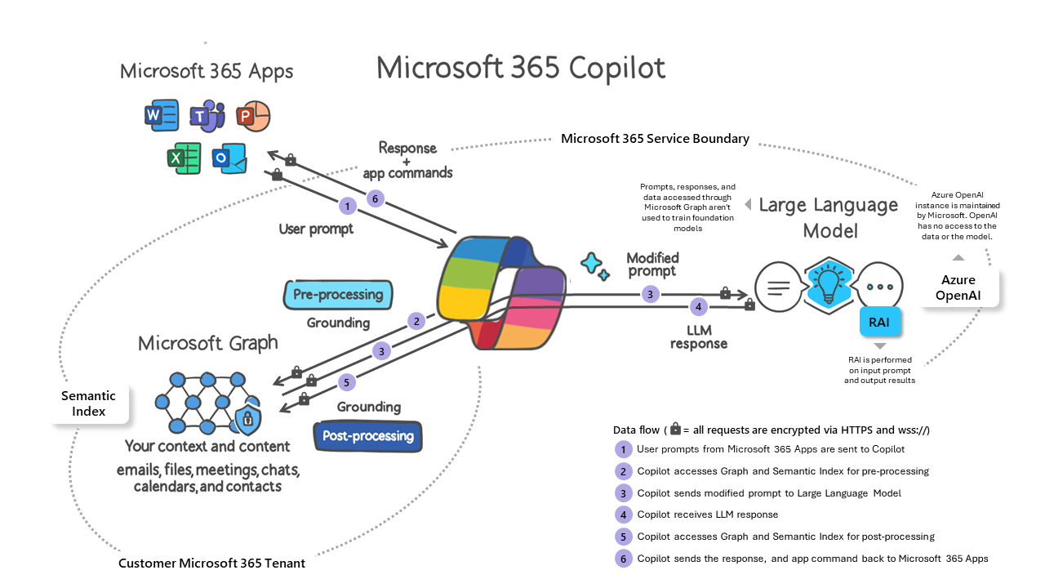
Credits - Microsoft.com

Slide 4
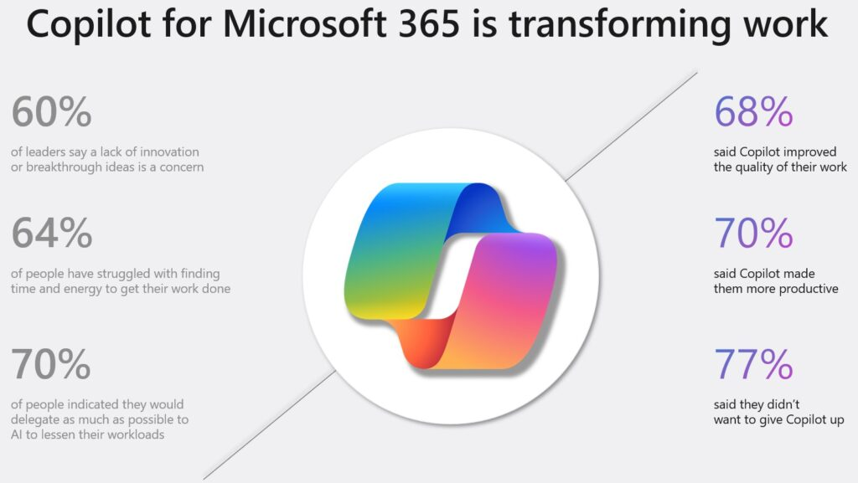
Copilot is finding acceptance …

Slide 5

Working Sessions
Notes:
This slide introduces the concept of working sessions and how Copilot can assist in various Microsoft Office programs. Mention that Copilot is an AI-powered tool that uses natural language processing to provide suggestions and automation for various tasks.

Slide 6

Copilot for Word
Summarizing a Word document
One min elevator pitch/taglines
Rewrite/a paragraph
Creating a new document (say from email/team chats/ppt)
What can Copilot do ?
Copilot can summarize a Word document fairly accurately
Copilot for Word provides assistance with writing and editing
It can create a document from a ppt
It can also offer grammar and spelling corrections
Notes:
Copilot for Word is a helpful tool for writers and editors who want to improve their writing. With its AI capabilities, Copilot can provide suggestions for word choice, grammar, and spelling to help users create high-quality documents.

Slide 7

Copilot for PowerPoint
What can Copilot do ?
Create ppt from Word, Generate a new ppt
Copilot for PowerPoint provides assistance with making and editing presentations
It can suggest design options and layouts to improve presentations
It can also offer quick formatting options and template suggestions
Notes:
Copilot for PowerPoint is an AI-powered tool that can help users make more engaging and professional presentations. It can offer suggestions for design, layout, and formatting, as well as provide quick access to templates and design elements. With Copilot, users can spend less time on tedious formatting and more time on perfecting their message.

Slide 8

Copilot for Outlook
What can Copilot do ?
Summarizing & Drafting an Email
Copilot provides assistance for writing and editing emails in Outlook
Copilot suggests spelling and grammar corrections for emails
Copilot can autocomplete phrases and suggest sentences to improve emails
Copilot can summarize email thread
Copilot can write email for various styles like executive, professional, friendly, etc.
Notes:
Copilot for Outlook is an AI-powered tool for Microsoft Outlook. It helps users write and edit emails in a more efficient way. Copilot suggests spelling and grammar corrections and can autocomplete phrases and sentences to make writing emails faster. By utilizing Copilot, users can focus on the content of their email rather than the mechanics of writing.

Slide 9

Copilot for Excel
What can Copilot do ?
Analyze Data, Draw Charts, Create Formula
Copilot is an AI-powered tool for Microsoft Excel
Copilot can analyze data and help users find insights and trends
Copilot can autocomplete formulas and suggest charts based on the data
Notes:
Copilot is a helpful tool for Excel users who want to easily analyze data and find insights. With its AI capabilities, Copilot can identify trends and patterns in data and provide suggestions for charts and formulas.

Slide 10

What Copilot can do for Teams
Copilot can assist with writing and editing messages in Teams
Copilot suggests spelling and grammar corrections for messages
Copilot can autocomplete phrases and suggest sentences to improve messages
Copilot can summarize message threads
Copilot can write messages for various styles like executive, professional, friendly, etc.
Notes:
Copilot is a great tool to use for your Teams communication needs. It can help you write messages faster and with more precision. Copilot can assist you with summarizing message threads and even write messages for you. Give Copilot a try today and see how it can make your communication better.

Slide 11

Next steps for Copilot learning
Explore more features and capabilities of Copilot
Attend a training session or webinar to learn more
Join Copilot user forums and connect with other users to learn tips and tricks
This Photo by Unknown Author is licensed under CC BY
Notes:
As you continue to work with Copilot, there are a number of ways to deepen your knowledge and get more comfortable with the tool. One option is to explore more of the features and capabilities of Copilot on your own. Another option is to attend a training session or webinar to learn more from experienced trainers. Finally, you can join user forums to connect with other users, learn tips and tricks, and stay up to date on new developments and updates to the tool.

Slide 12

References
Copilot Adoption MS
Copilot Prompts
Lessons from Early Copilot Users
Introduction to Microsoft Copilot (Coursera)
4 Steps to be Copilot Ready (Forbes)

Slide 13

Thank You

